Slide 1



SAVEETHA SCHOOL OF ENGINEERING
SAVEETHA INSTITUTE OF MEDICAL AND TECHNICAL SCIENCES
COURSE CODE:
CSA1590 CLOUD COMPUTING FOR BIG DATA ANLYTICS FOR VIRTUAL CLUSTERS
TOPIC:
Design And Implement A Cloud-based E-learning Through Any Open Cloud Platform
FACULTY NAME:Dr.Gnana Soundari
By,
NAME :k.Murali krishna
REG.NO :192211490

Slide 2
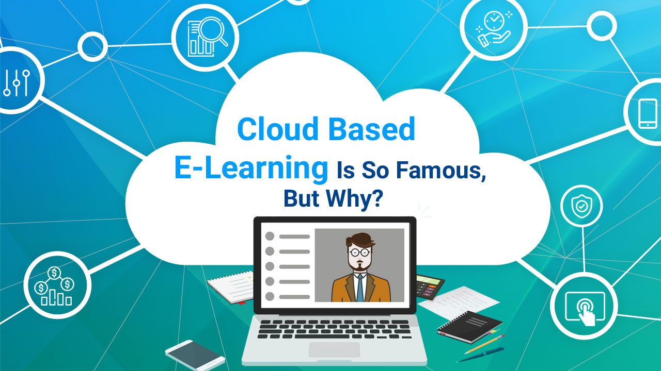
Introduction to Cloud-Based E-Learning
Cloud-based e-learning leverages internet resources to deliver educational content.
This approach facilitates access to learning materials anytime and anywhere.
Open cloud platforms provide cost-effective solutions for scalable education systems.
1
Notes:
Image source: https://www.pinterest.com/pin/cloud-based-elearning-is-so-famous-but-why-hexalearn-blog--452611831303614801/

Slide 3
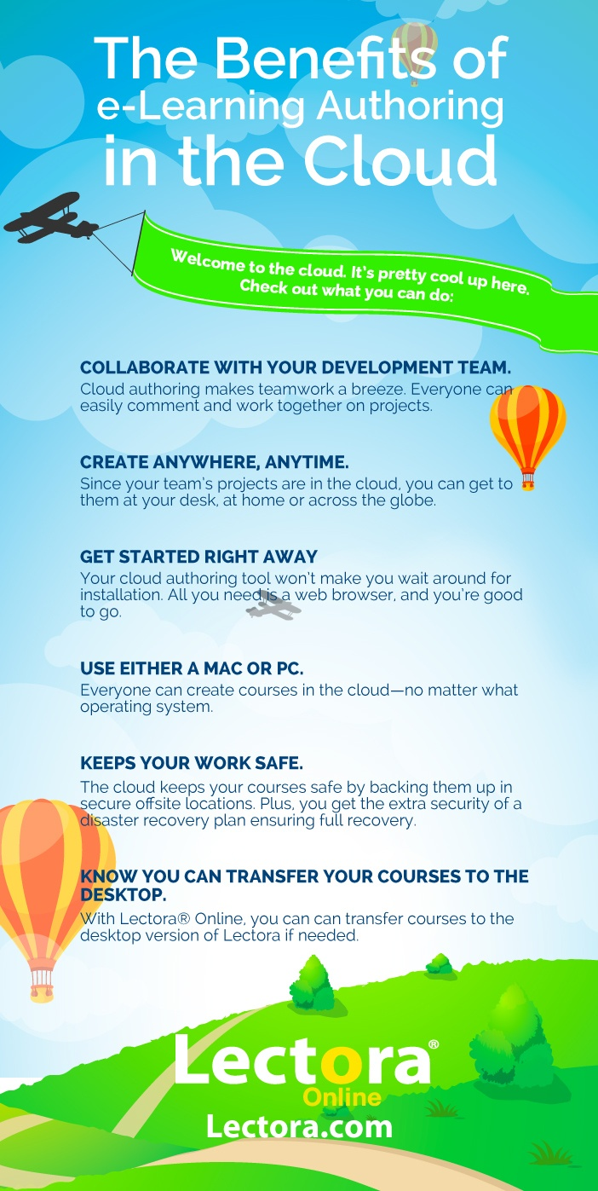
Benefits of Cloud-Based E-Learning
Flexibility in accessing courses enhances the learning experience for students.
Instructors can easily update materials and resources in real time.
Cloud solutions often enable collaborative learning through shared tools and platforms.
2
Notes:
Image source: https://elearninginfographics.com/top-6-benefits-cloud-elearning-authoring-infographic/

Slide 4
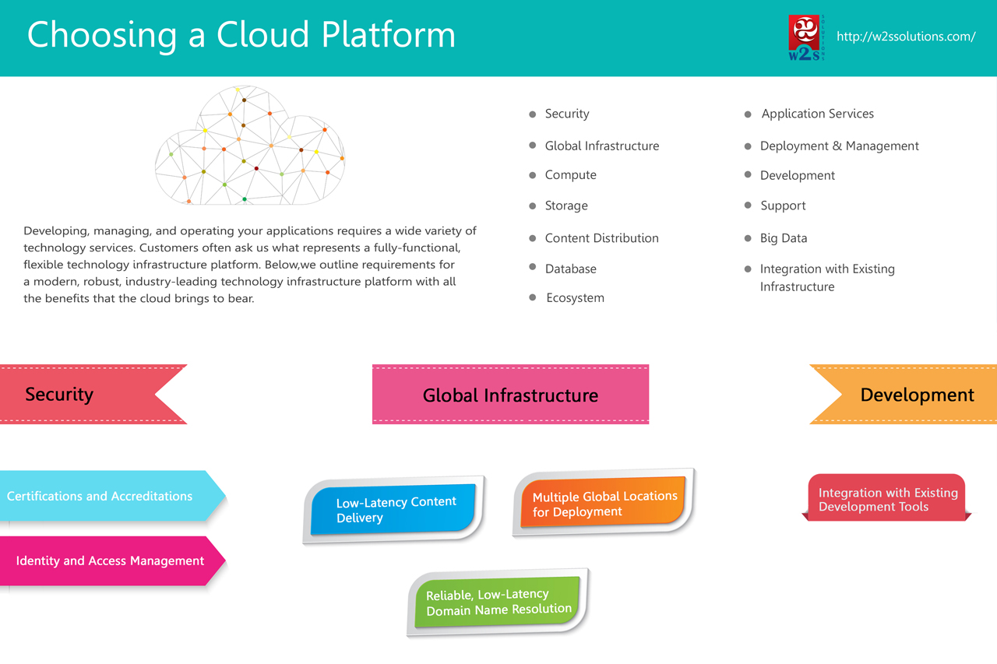
Choosing the Right Open Cloud Platform
Key considerations include scalability, security, and ease of use.
Popular open cloud platforms include OpenStack, Google Cloud Platform, and AWS Educate.
Assessing the community support and documentation is essential for successful implementation.
3
Notes:
Image source: https://www.w2ssolutions.com/blog/choosing-a-cloud-platform-infographics/

Slide 5
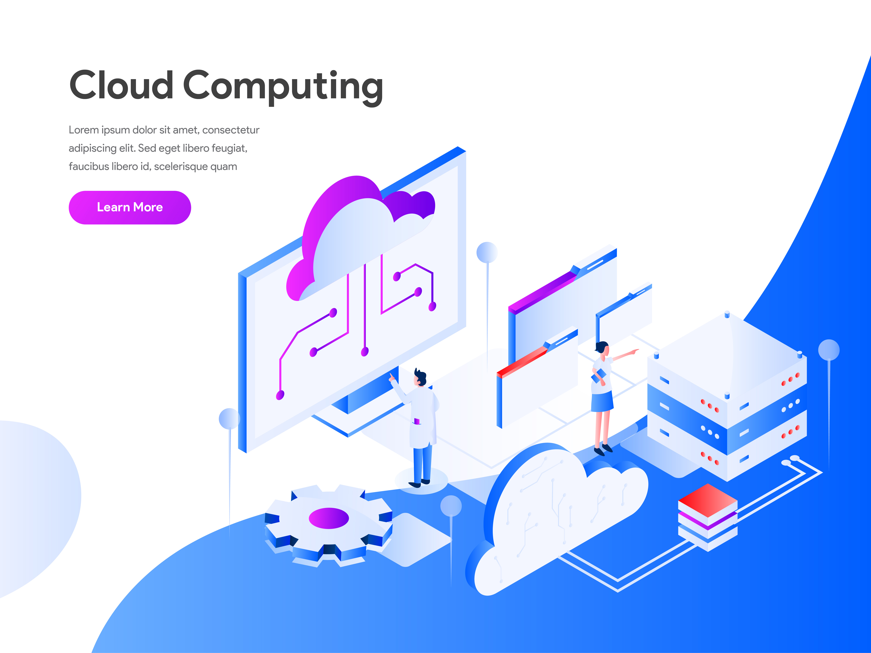
Designing the E-Learning Architecture
The architecture should include a user-friendly interface for students and educators.
Backend systems must support data management, authentication, and analytics.
Integrating APIs can enhance functionality and facilitate third-party tool usage.
4
Notes:
Image source: https://www.vrogue.co/post/learning-architecture-design-best-design-idea

Slide 6
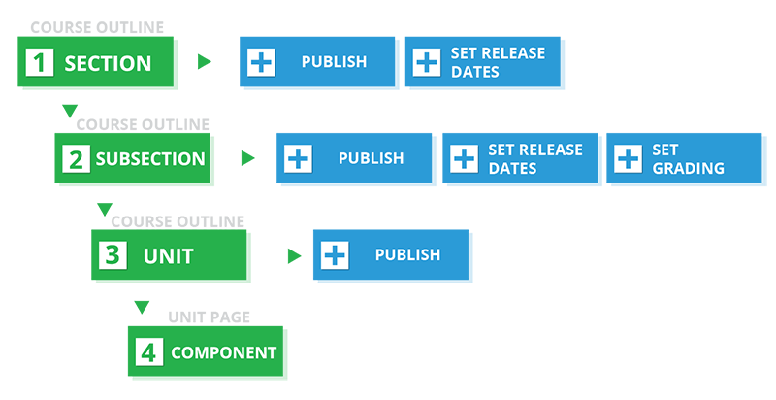
Course Content Development
High-quality content is crucial for student engagement and retention.
Interactive elements like quizzes, videos, and forums can enhance learning.
Regular updates and feedback loops are necessary to keep content relevant.
5
Notes:
Image source: https://edx.readthedocs.io/projects/edx-partner-course-staff/en/latest/developing_course/workflow.html

Slide 7

Implementing User Management
User profiles should store individual progress and preferences for personalized learning.
Role-based access controls ensure that students and educators have appropriate permissions.
Integration with social media can facilitate peer connections and networking opportunities.
6
Notes:
Image source: https://milgrasp.com/features/user_management.html

Slide 8
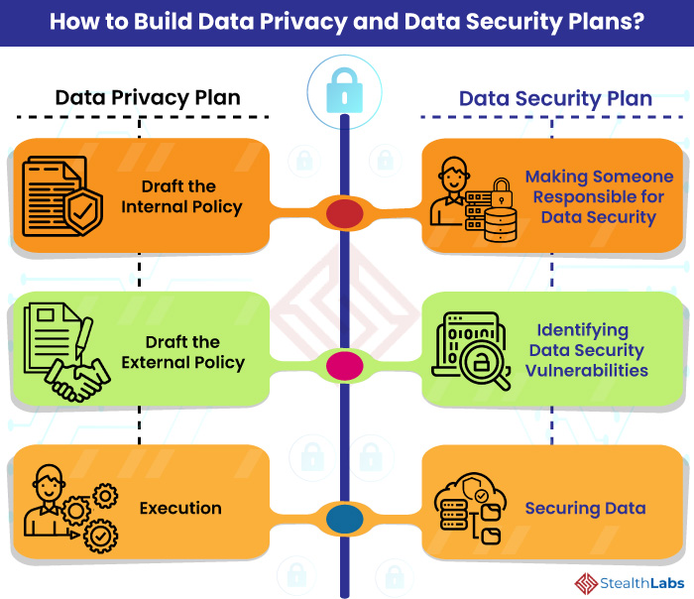
Ensuring Data Security and Privacy
Implementing strong encryption protocols is vital to protect sensitive information.
Regular audits and compliance checks help maintain data integrity and privacy.
Educating users about safe online practices can reduce security risks.
7
Notes:
Image source: https://stealthlabs.demolobby.com/blog/data-security-vs-data-privacy-an-imperative-distinction-to-protect-data/

Slide 9
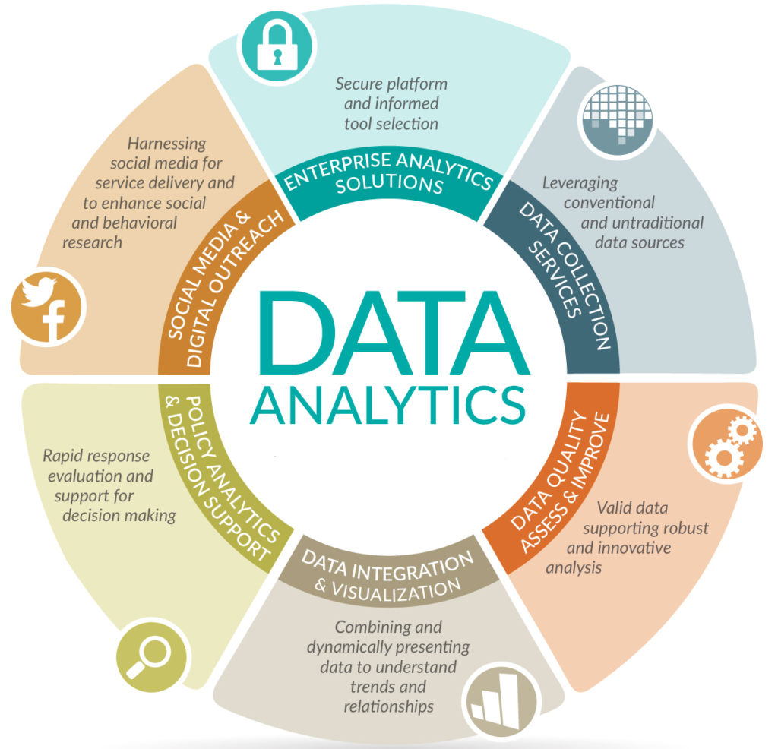
Leveraging Analytics for Improvement
Analytics tools can track student engagement and performance metrics.
Data-driven insights enable educators to tailor instruction to individual needs.
Continuous assessment of course effectiveness is essential for ongoing improvement.
8
Notes:
Image source: https://www.vrogue.co/post/top-5-data-analytics-methodologies-analytics-yogi

Slide 10

Marketing the E-Learning Platform
A robust marketing strategy can help attract students and educators alike.
Utilizing social media, webinars, and partnerships can expand outreach.
Highlighting unique features and success stories can build credibility and interest.
9
Notes:
Image source: https://www.edunext.co/es/articles/5-mejores-practicas-de-marketing-para-su-iniciativa-de-e-learning/

Slide 11

Future Trends in Cloud-Based E-Learning
Artificial intelligence and machine learning are set to revolutionize personalized learning.
Virtual reality and augmented reality can create immersive educational experiences.
conclusion
Implementing cloud-based e-learning through open cloud platforms revolutionizes education by providing scalable, accessible, and secure learning environments, fostering global educational opportunities and innovation.
10
Notes:
Image source: https://www.slidemake.com

Slide 12


